Slide 1

Project Presentation
Entitled
“Health Monitoring system For Industrial Motors Using IoT”
:Presented By:
Amit Kumar(U19EC073)
Anurag kharwar(U19EC061)
Dinesh Choudhary(U19EC078)
:Guided By:
Dr. Anand D. Darji
Associate Professor
DEPARTMENT OF ELECTRONICS ENGINEERING
Sardar Vallabhbhai National Institute of Technology Surat-395007, Gujarat, INDIA.

Slide 2
PRESENTATION OUTLINES
Introduction
Methodology
Motivation
Testing & Result
Literature survey
Conclusion
Hardware Selection
Future Scope
Software Selection
References
Notes:
Tell about the flow on how we will proceed

Slide 3
INTRODUCTION

Slide 4
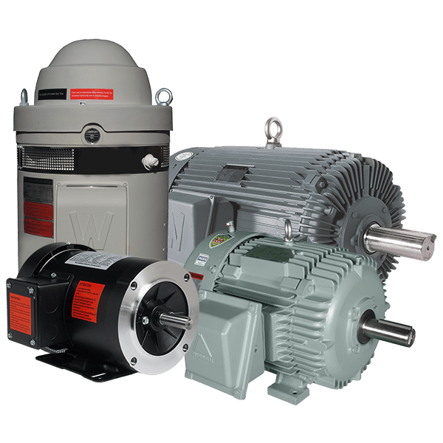
Motors are now the most extensively utilised electrical equipment for industrial, home, and commercial uses.
Notes:
Tell about how much motor are used

Slide 5
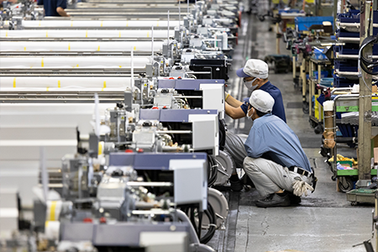
Production Lines are dependent on motors. If one go wrong, everything halts
Notes:
If something go wrong everything goes halt. Give an example.

Slide 6
MOTIVATION

Slide 7
MOTIVATION
Efficiency
Maintenance
Product cost
When a motor fails, the entire industry or factory comes to a halt, and the supply chain is disrupted
Help optimize maintenance schedules, allowing for timely maintenance and repairs to be performed before a failure occurs.
Solutions in the market are very costly. And does not provide a centralised Iot Platform

Slide 8
LITERATURE SURVEY

Slide 9
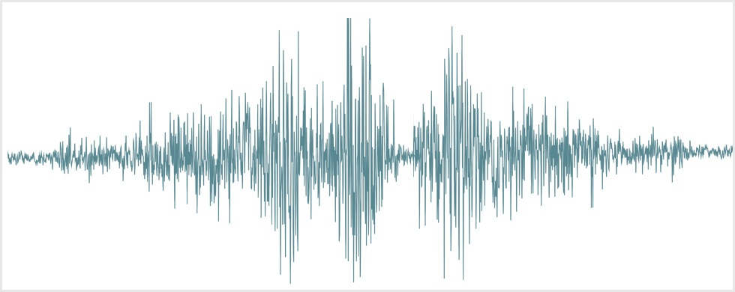
Why Vibration
Current
Vibration
Visual
Temperature
Sound

Slide 10
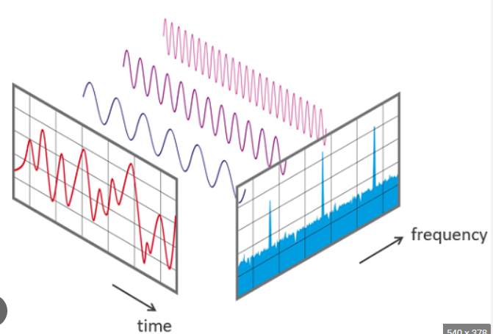
Fourier analysis
Converting a signal from its original time domain to a representation in the frequency domain

Slide 11
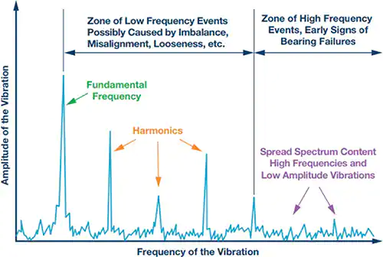

Slide 12
RPM of Motor can be known from specification of motor or from the Tachometer
Fundamental frequency can be observed from the FFT plot of the vibration of motor
RPM of Motor = Fundamental Frequency * 60
Notes:
As we know vibration repeat itself in sync with the rotation of motor

Slide 13

Firebase
We have used Firebase RTDB(Realtime Database)

Slide 14
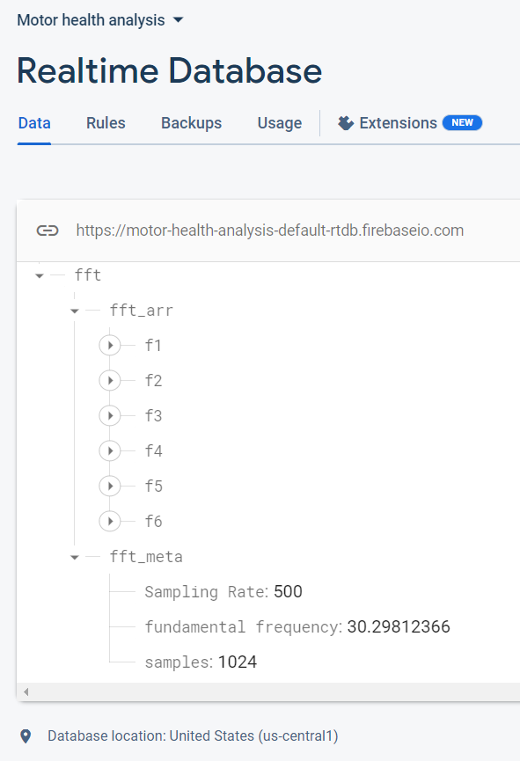
Data Organisation on
Firebase

Slide 15


Website
Used basic web-development stack of HTML, CSS, JavaScript
Chart.js is used to plot the FFT

Slide 16
HARDWARE SELECTION

Slide 17
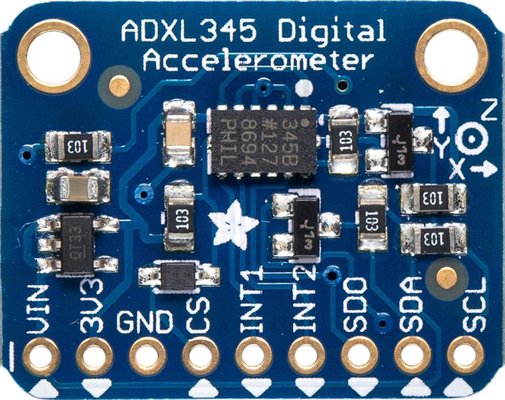
ADXL345
Digital Accelerometer
Sampling Rate - 0.10 Hz to 3.2 KHz
Support both I2C and SPI
Cost - 140 ₹
3-axis accelerometer with high resolution (13-bit) measurement at up to ±16 g

Slide 18
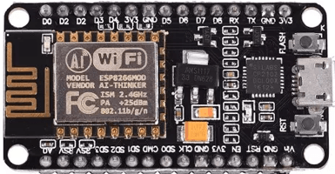
ESP8266
4MB of flash memory and 520KB of SRAM
Inbuilt Wifi support
Support UART/SPI/I2C/I2S
Cost - 280 ₹

Slide 19
SOFTWARE SELECTION

Slide 20

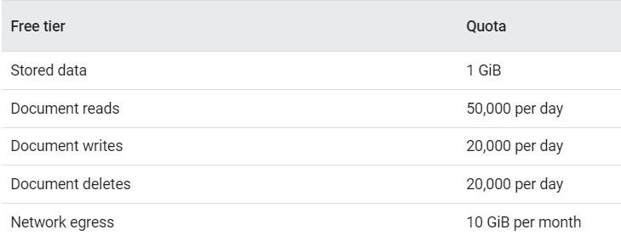
Firebase

Slide 21
METHODOLOGY

Slide 22
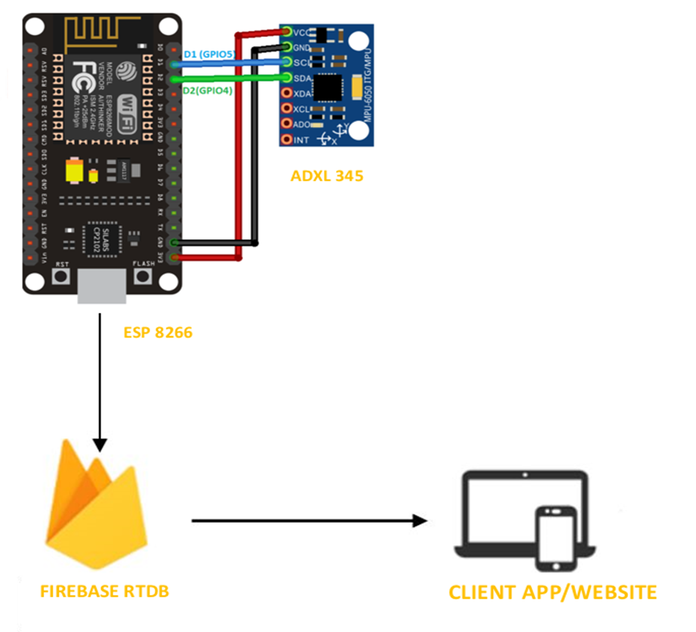
Process Flow

Slide 23
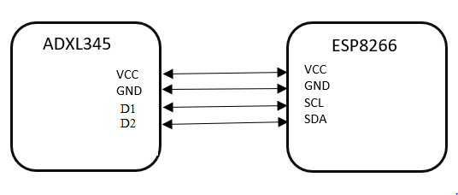
Connection between ADXL345 and ESP8266

Slide 24
Sampling the vibrations of motor
We know that industrial motor lies below the RPM of 7000.
Which equals to 116.6 Hz ⇒ 120 Hz.
According to nyquist formula. We need to sample at the rate of at least 2 times the frequency to avoid losing information that is in the signal.
For safe side we take it 4 times ⇒ 120 * 4 Hz ⇒ 480 Hz
So let us take sampling rate of 500 Hz.
As we take the data we store it in an array.
And use that array for further processing.

Slide 25
Processing of the Data
We are using arduinoFFT.h library to calculate the FFT on array.
After that combining it with other information like Sampling Rate, Samples.
We convert it to JSON object.
We are using Firebase_ESP_Client.h library to send the JSON to Firebase and store it in RTDB.

Slide 26
Presentation of the Data
Data is fetched from firebase RTDB to website.
The array and meta data is used to plot the FFT using the chart.js
The delay between two observation is approx 24 sec and may vary due to the delay in updating and fetching data from firebase.

Slide 27
TESTING AND RESULT

Slide 28
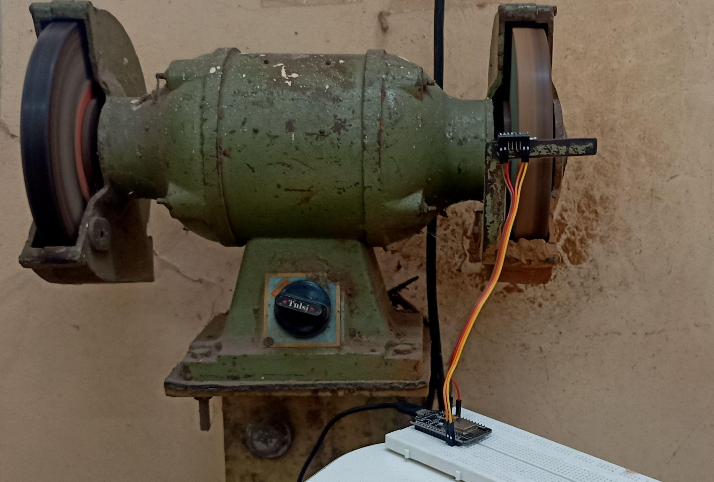
Testing on Grinding Motor with 1100 RPM

Slide 29
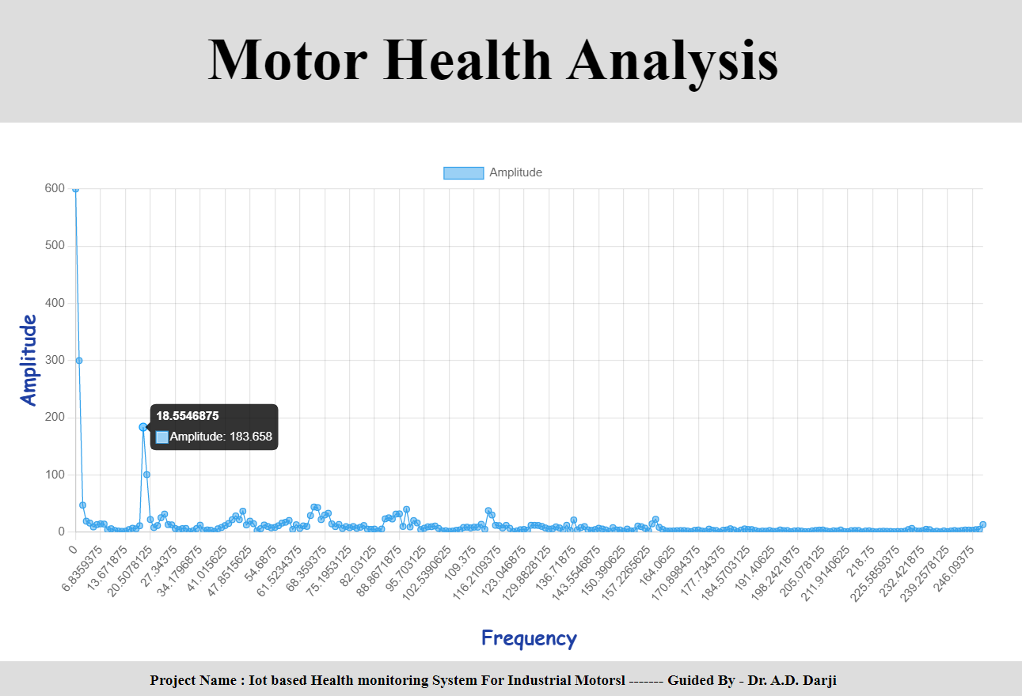
Sampling rate= 500 Hz
Fundamental Frequency from FFT= 18.55 Hz
Motor RPM= 1100 RPM Predicted rpm= 18.55*60 = 1113 RPM

Slide 30
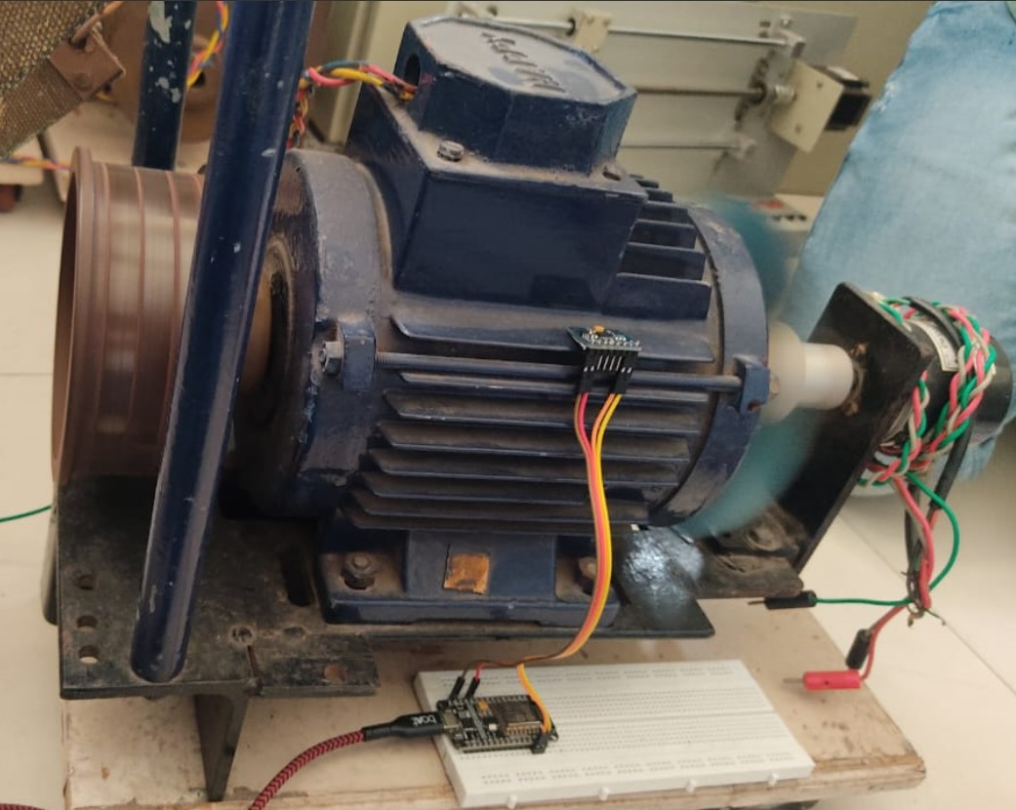
Motor with Wobbly Shaft at 1680 RPM

Slide 31
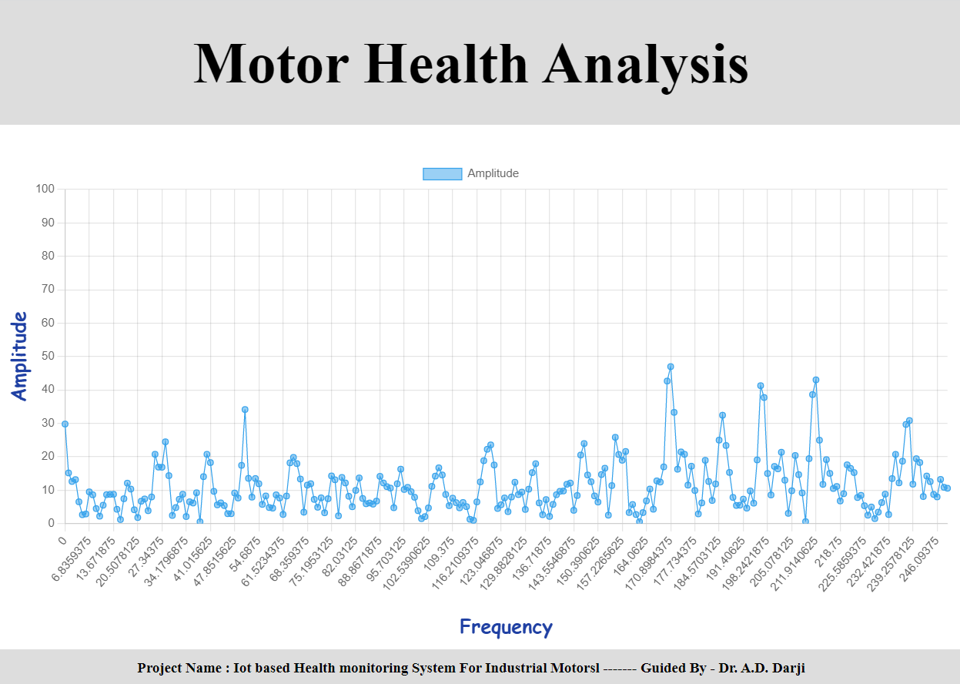
Sampling rate= 500 Hz
Fundamental Frequency from FFT= Not identified
Motor RPM= 1680 RPM Predicted rpm= Not identified

Slide 32
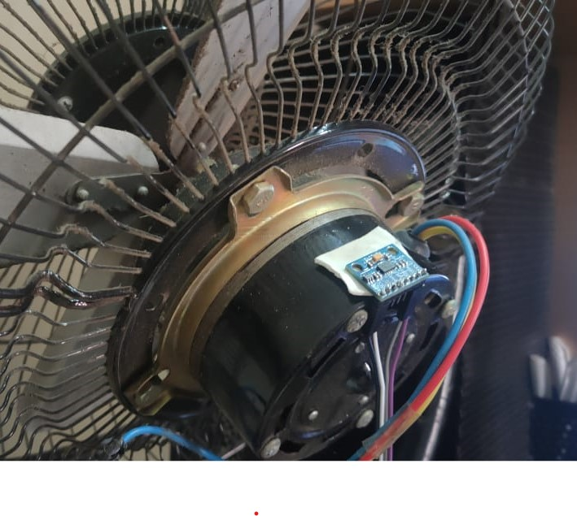
Fan Motor With 1800 RPM

Slide 33
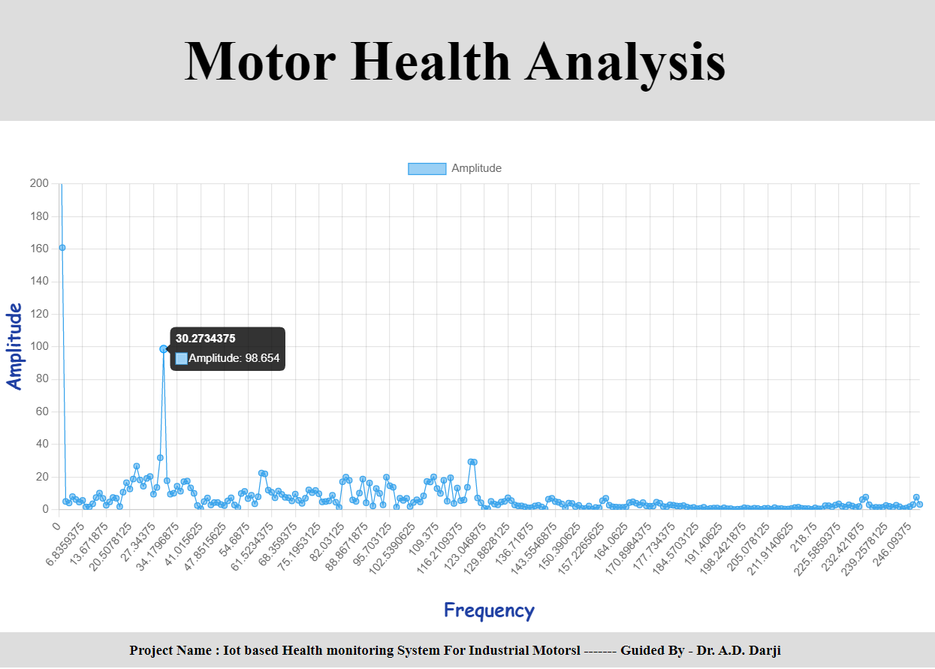
Sampling rate= 500 Hz
Fundamental Frequency from FFT= 30.27 Hz
Motor RPM= 1800 RPM Predicted rpm= 30.27*60=1816.4 RPM

Slide 34
CONCLUSION

Slide 35
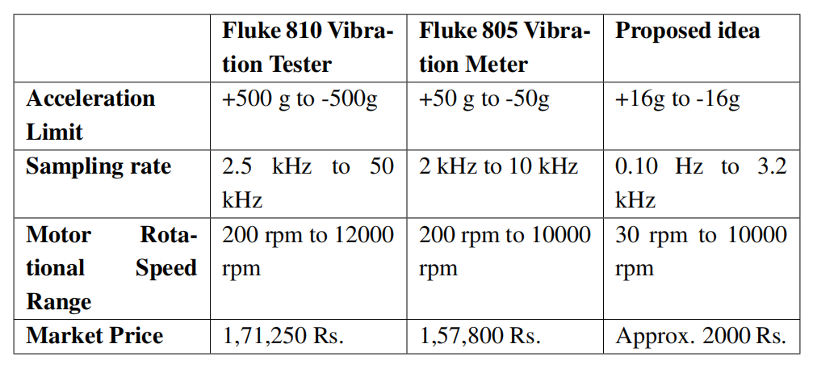
Comparison with existing product

Slide 36
Developed a MVP to plot the frequencies which
Accessible from everywhere
Price is very less
Supports upto 10000 RPM of Motors
Portable
Can be used to setup a network in Industry
Used to analyse the Motor Health

Slide 37
Future Scope

Slide 38
Future Scope
Machine Learning
The Network
Improving the predictive maintenance capabilities by incorporating machine learning algorithms and predictive analytics, which can provide more accurate predictions of motor failures.
To build a platform where a complete network can be setup in factories and all motors are monitored always in real time.

Slide 39
Thankyou
Guided By:
Dr. Anand D. Darji
Associate Professor
max growth
Amit Kumar(U19EC073)
Anurag kharwar(U19EC061)
Dinesh Choudhary(U19EC078)

